Slide 1
Advanced Numeration

Slide 2

Content
TYPES OF NUMBERS
Conversion of a decimal number to fraction
DIVISIBILITY RULE
REMAINDER THEOREM
Power Cycle and Unit Digit Concept
FACTORS AND MULTIPLES
i) Number of factors
ii) Sum of factors
iii) Product of factors
HCF & LCM
AP & GP

Slide 3
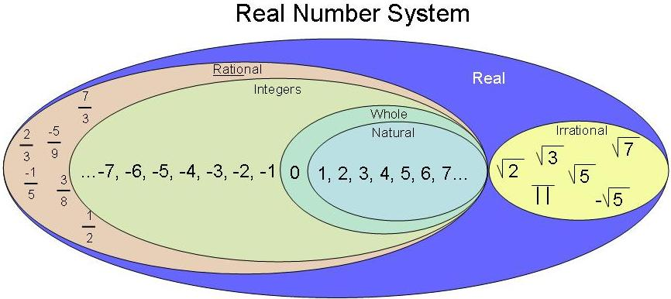
Types of numbers

Slide 4
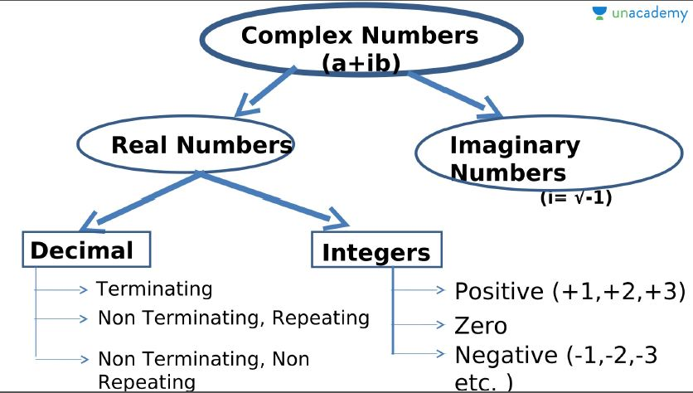

Slide 5
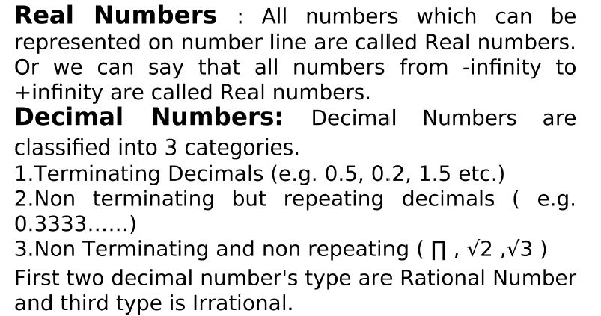

Slide 6
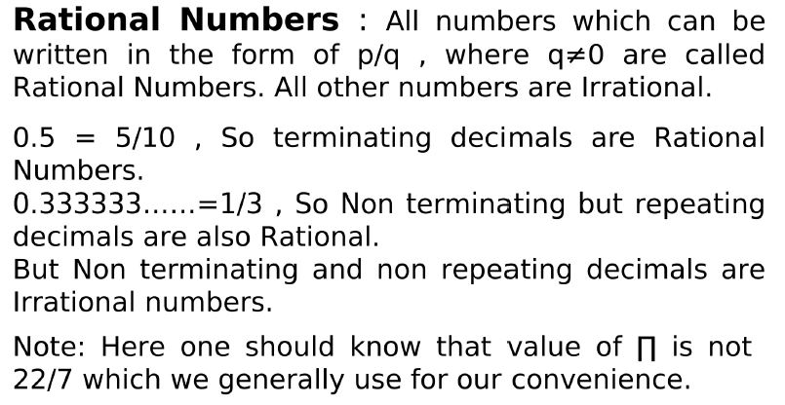

Slide 7
Rational no. b/w a and b = (ak+b)/(k+1)
Irrational no. b/w a and b = √ab, …..
How to find whether a no is Prime or not

Slide 8
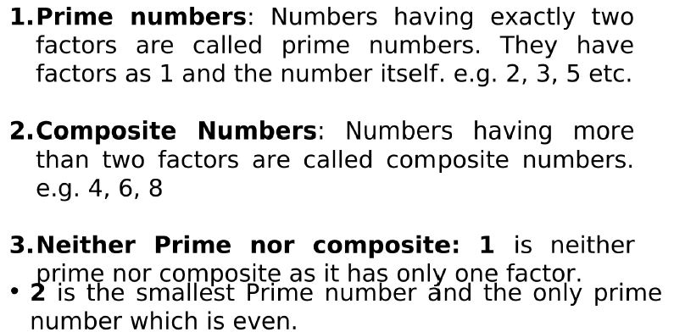
Positive Integers: Positive integers can be categories in many ways.

Slide 9
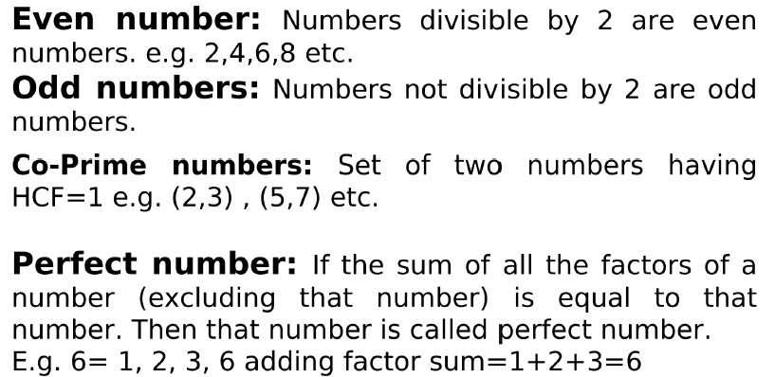

Slide 10
Important rules related to Even and Odd numbers:
odd ± odd = even;
even ± even = even;
even ± odd = odd
odd × odd = odd;
even × even = even;
even × odd = even.
odd^{(any number)} = odd
even^{(any number)} = even
How to find whether a no is Prime or not

Slide 11
How to find if a number is prime or not?
N is a prime number if it is not divisible by numbers lesser than √N.
Example: 191 is a prime number since it is not divisible by 2, 3, 5, 7, 11 and 13 [numbers less than √191 (≈14)].
Note: Prime numbers will always be in the form (6k±1) where k= 1, 2, 3....
But not all (6k±1) will be a prime number.
(6k±1)
prime numbers

Slide 12
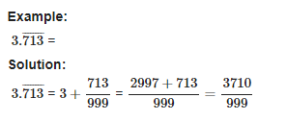
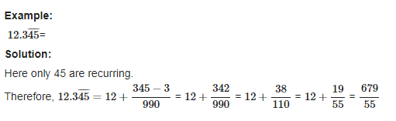
Conversion of a decimal number to fraction:

Slide 13
Q. Find the rational form of the recurring rational 0.77777777……
[A] 11/99
[B] 1/3
[C] 7/9
[D] 13/30

Slide 14
Q. Convert 0.555555……………. into P/Q

Slide 15
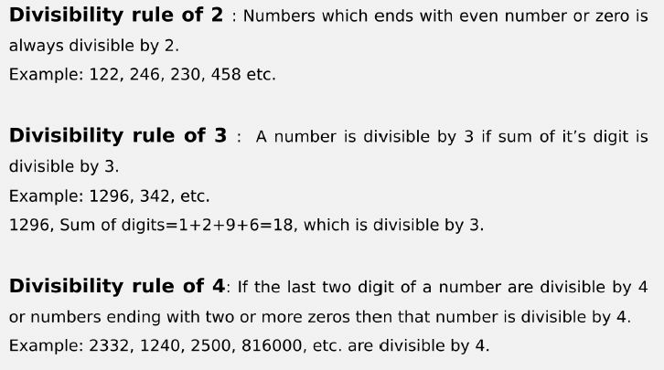
Divisibility Rules

Slide 16
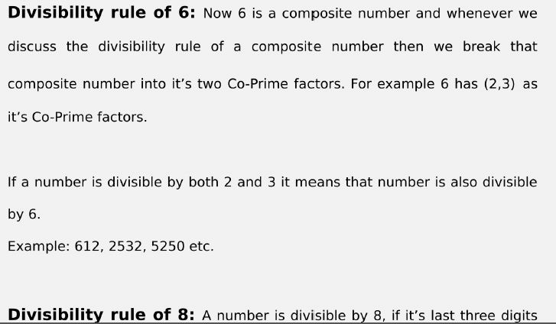

Slide 17
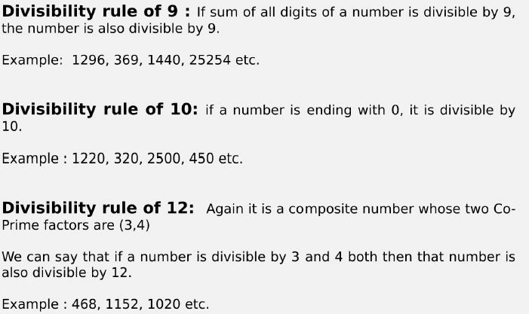

Slide 18
Any other numbers can be written in terms of the numbers whose divisibility is already known.
Example: 15 = 3 x 5
18 = 2 x 9
33 = 3 x 11
Note: The numbers expressed should be co-prime (i.e., the HCF of the two numbers should be 1)
Example: 40 = 4 x 10 is wrong because HCF(4,10) is 2.
∴ 40 = 5 x 8 because HCF(5,8) is 1.
How to find whether a no is Prime or not

Slide 19
Question: If number 1792N is divisible by 3. How many values N can take?
[A] 4
[B] 5
[C] 3
[D] 6

Slide 20
Question: What should come in place of K if 5677K4 is divisible by 9?
[A] 7
[B] 8
[C] 9
[D] 2

Slide 21
Question: For what values of P number 339369P36 is exactly divisible by 3.
[A] 1
[B] 4
[C] 6
[D] 7

Slide 22
Question: For what values of N number 9666N is exactly divisible by 3.
[A] 2 & 8
[B] 4 & 6
[C] 3 & 6
[D] 6 & 8

Slide 23
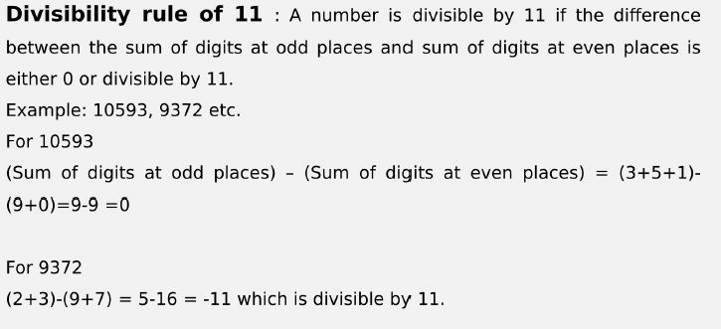

Slide 24
Question: For what values of N number 85N3 is exactly divisible by 11.
[A] 1
[B] 0
[C] 3
[D] 4

Slide 25
Question: What should come in place x if 396x is divisible by 88?
[A] 6
[B] 8
[C] 0
[D] 4

Slide 26
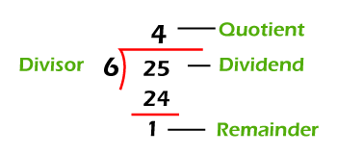
Remainder theorem
Dividend= (Divisor × Quotient + remainder)

Slide 27
A number when divided successively by 4 and 5 leaves remainders 1 and 4 respectively. When it is successively divided by 5 and 4 the respective remainders will be
4,1
3,2
2,3
1,3
Notes:
C

Slide 28
A number when divided by 899 gives a remainder 63. If the same number is divided by 29, the remainder will be :
10
5
4
2
Notes:
B

Slide 29
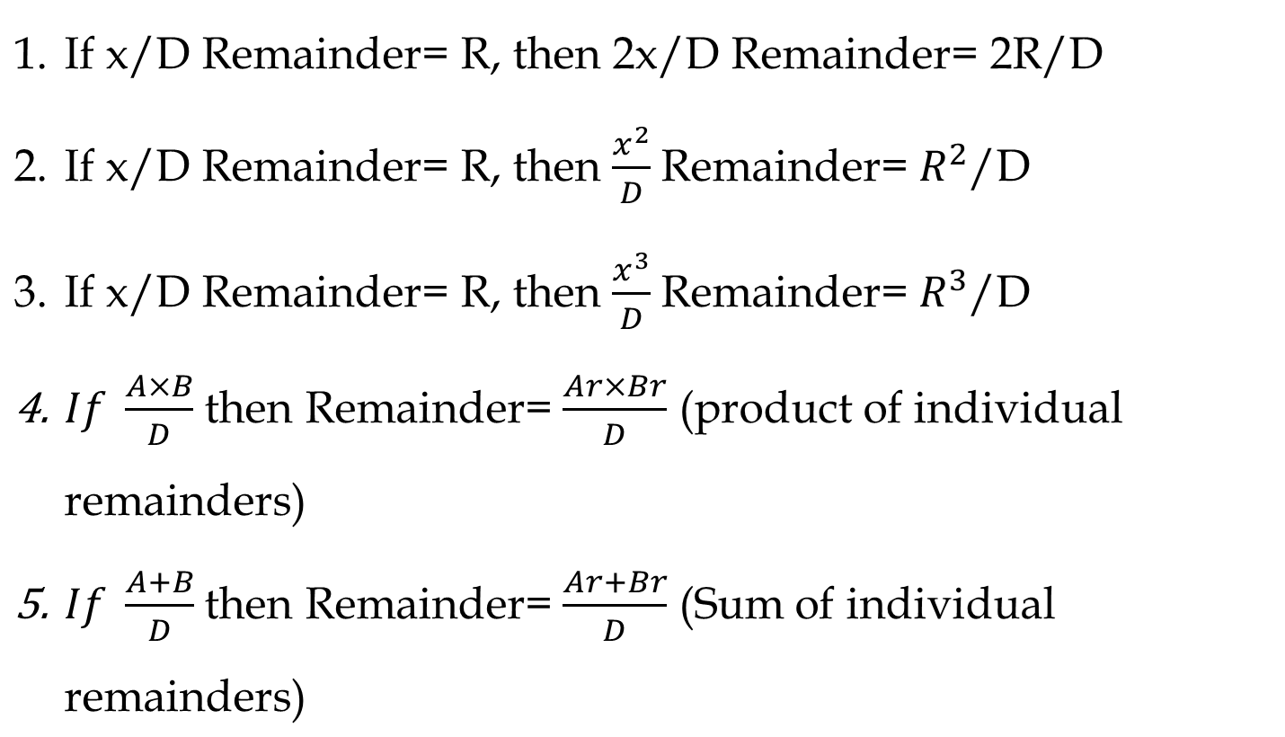
Important Rules

Slide 30
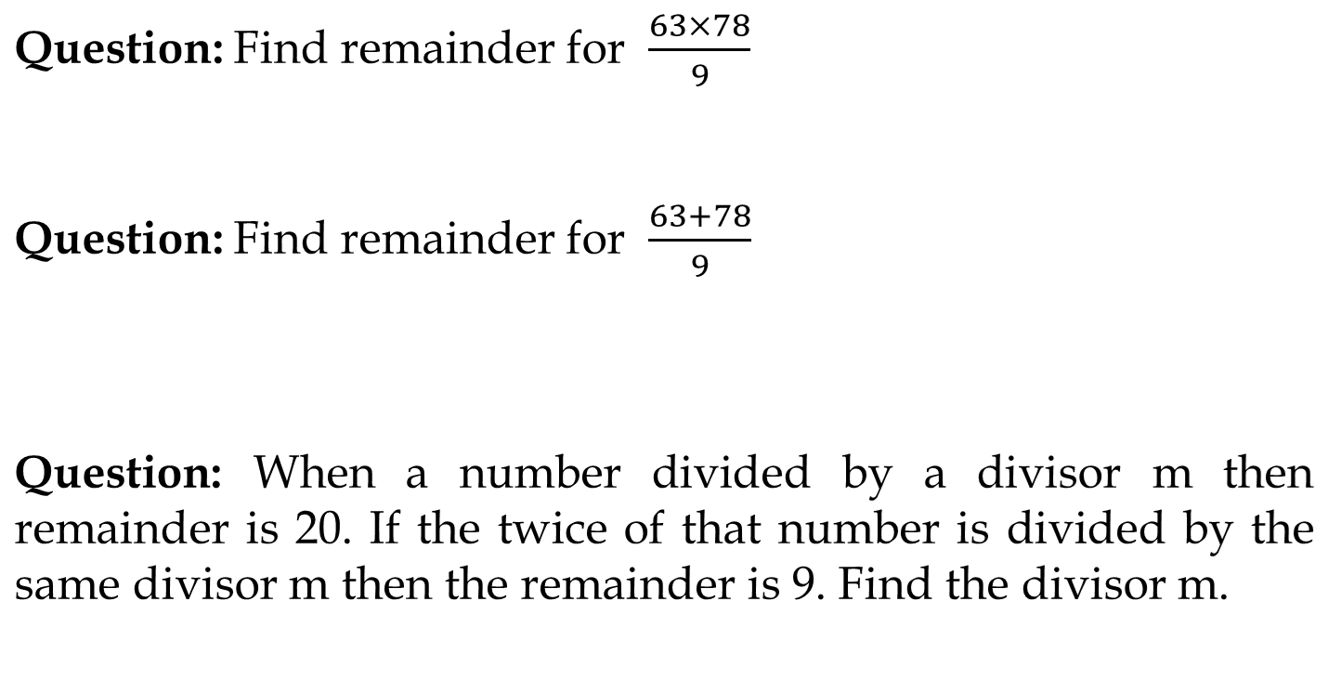

Slide 31
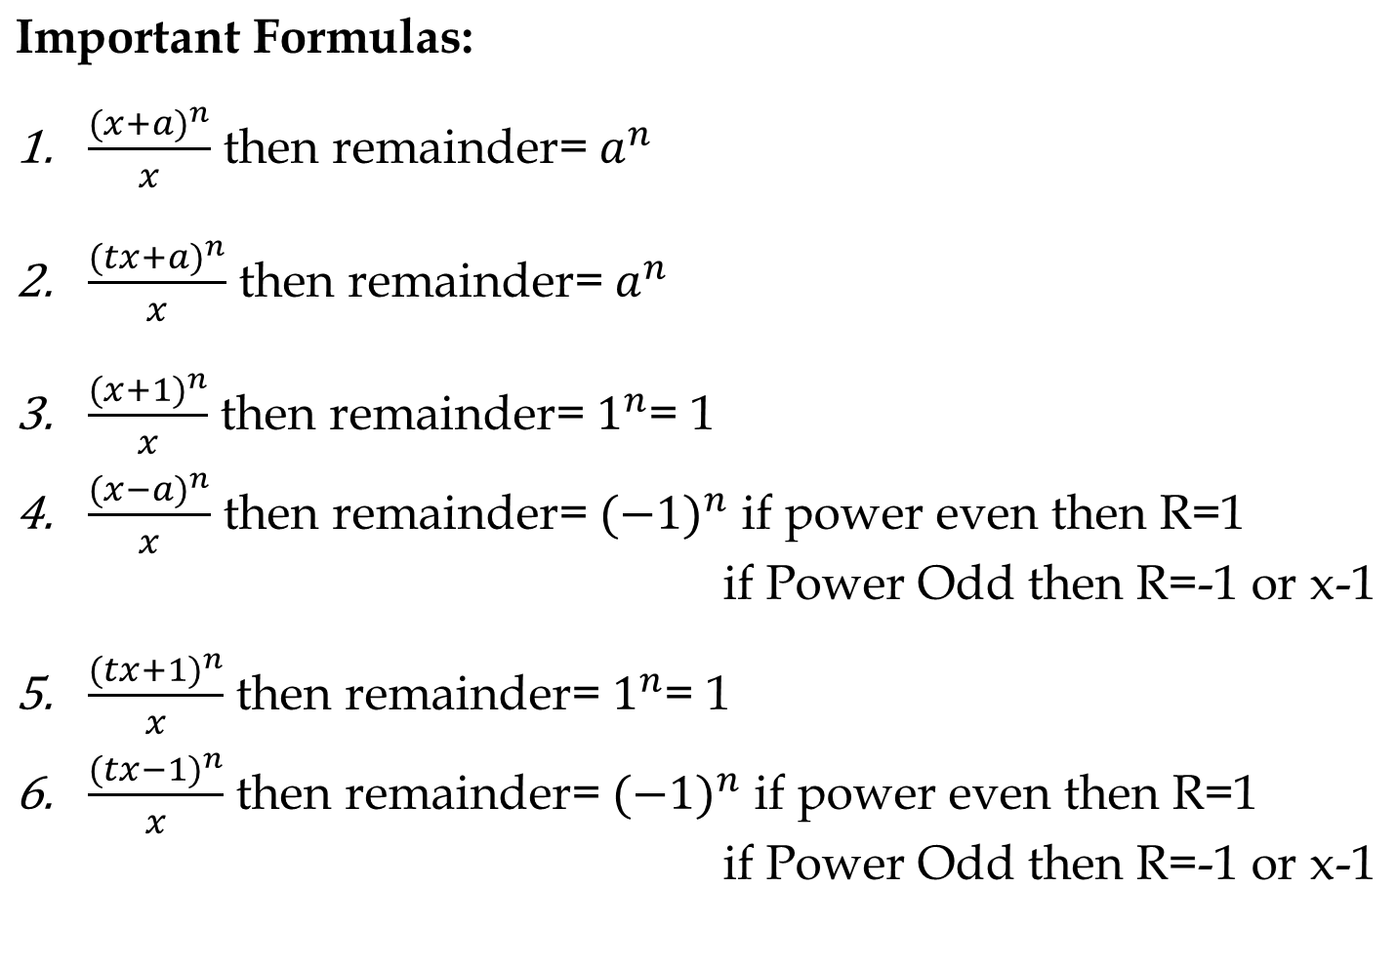

Slide 32
Remainder Cyclicity:
Example: What is the remainder when 2^202 is divided by 7?
2^1/7 = R(2)
2^2/7= R(4)
2^3/7 = R(1)
The next three remainder values will be the same. i.e., The remainder pattern is 2,4,1, 2,4,1, 2,4,1.....The size of the pattern is 3.
Now divide the power by number of repeating values (3) to choose the remainder.
Choose the nth value in the cycle if the remainder is n except for the last value whose remainder should be 0.
202/3 = R(1).
The 1st value in the cycle is 2.
Note: While finding the remainder pattern if the remainder becomes 1, then the process can be stopped as the it will always repeat after 1.
∴ 2^202/7 = R(2)

Slide 33
Note: Do not cancel any numerator value with the denominator value as the remainder will differ.
R(6/4) ≠ R(3/2)
6/4 = R(2)
But 3/2 = R(1)
If you want to cancel out numerator and denominator by a certain value then at last we also need to multiply the remainder by the same value in order to get correct remainder.

Slide 34
Find the remainder when 35¹¹³ is divided by 9.
1
2
8
7
Notes:
C

Slide 35
Find the remainder when (67⁶⁷ + 67) is divided by 68.
1
-1
66
3
Notes:
C

Slide 36
Find the remainder when (17) ²³ + (29)²³ is divided by 23.
0
1
2
3
Notes:
A

Slide 37
Find the remainder when 7⁵¹² is divided by 400.
8
7
5
1
Notes:
D

Slide 38
Q) Remainder when 4^99 is divided by 20?
[A] 1
[B] 4
[C] 2
[D] 8
Notes:
B

Slide 39
Q) Remainder when 3*(5^500) is divided by 1500?
[A] 125
[B] 1
[C] 375
[D] 250
Notes:
C

Slide 40
Unit Digit Concept
Right most digit of a number is called Unit digit.
For e.g. 278 × 623 what will be the unit digit?

Slide 41
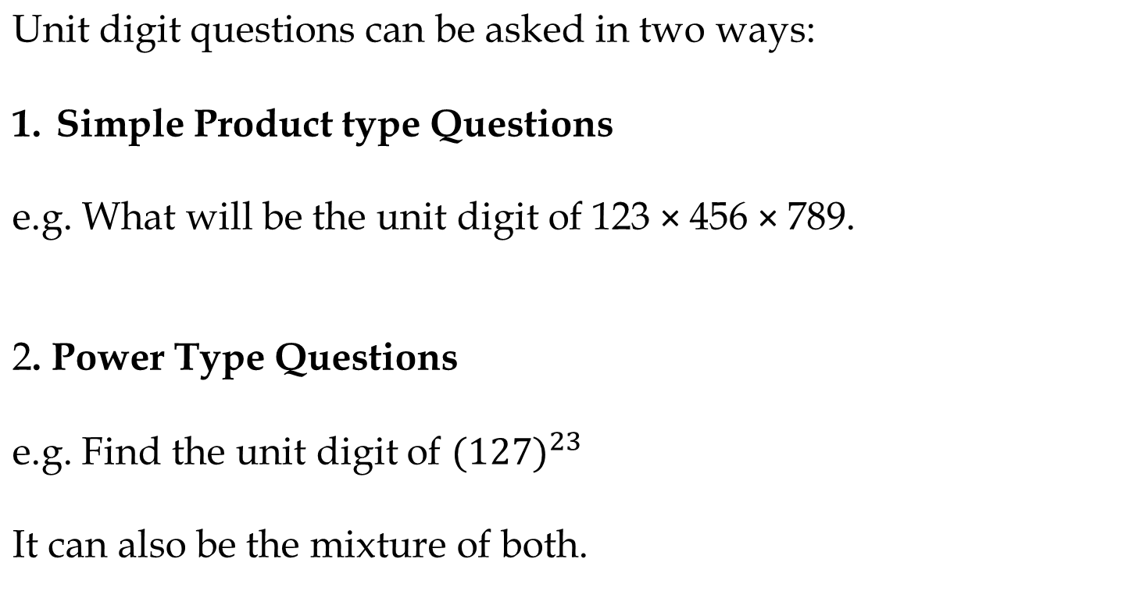

Slide 42
We can categories in three category:
Numbers ending with (0, 1, 5, 6)
Numbers ending with (4,9)
Numbers ending with (2,3,7,8)
Each category follow a certain rule.

Slide 43
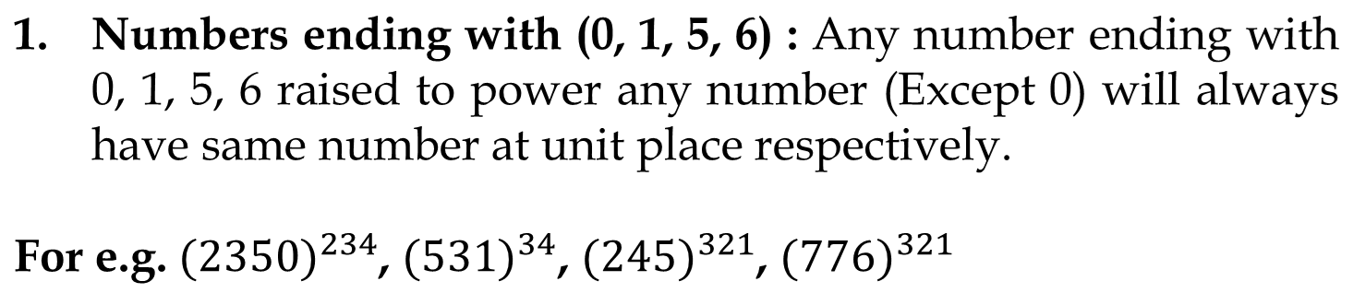

Slide 44
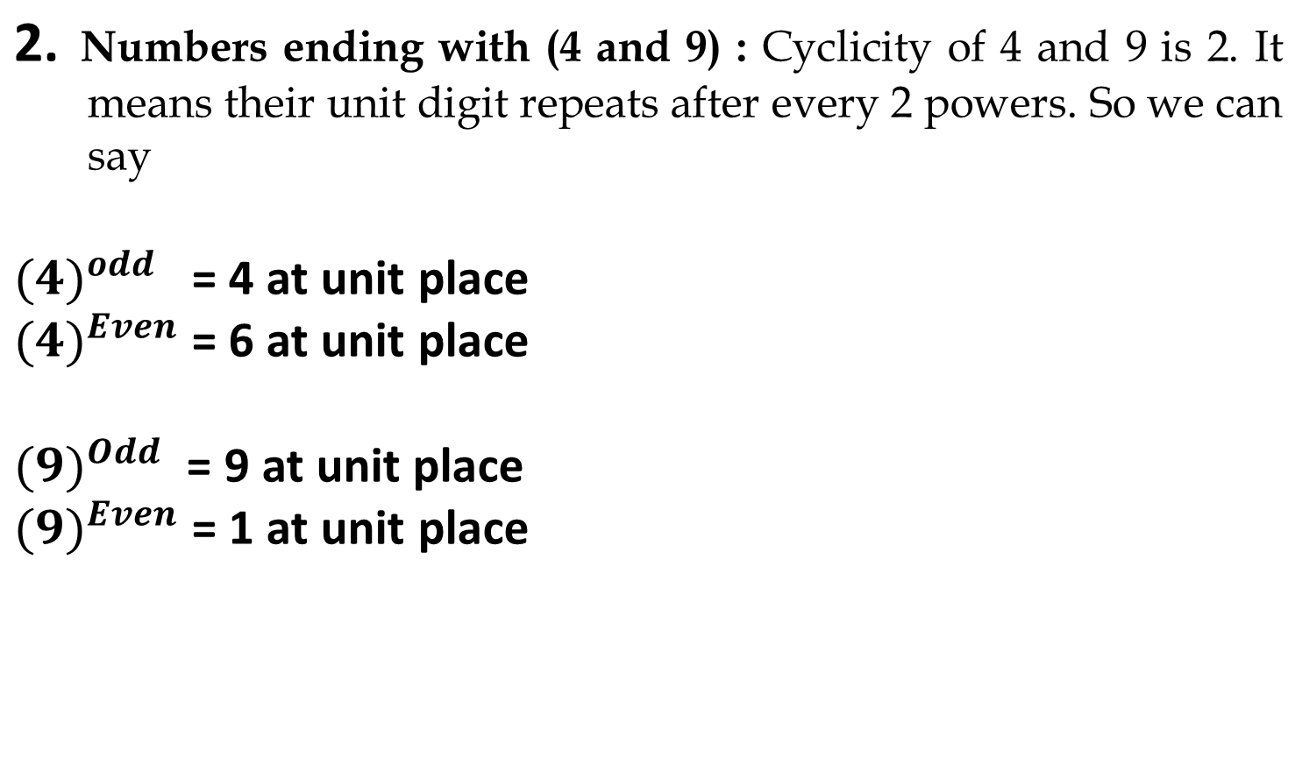

Slide 45
3. Numbers ending with (2,3,7,8) : All numbers have cyclicity of 4, it means after every 4th power the unit digit pattern will be same.
In these type of questions we will divide the power by cyclicity (i.e. 4) so that we will know how many cycles have been completed and we will try to find remainder. And unit digit will be (2,3,7,8)^Rem
Note: If remainder is zero then we take highest power of that cycle which is 4. or we can say (2,3,7,8)^4

Slide 46
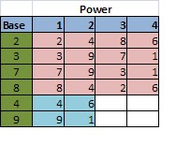
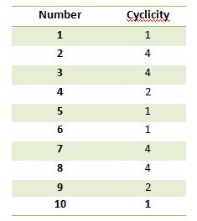
Choose the nth value in the cycle if the remainder is n except for the last value whose remainder should be 0.

Slide 47
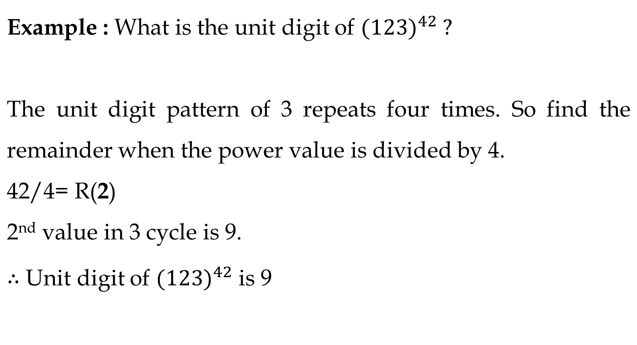
How to find whether a no is Prime or not

Slide 48
What is the unit digit in the product (3⁶⁵ x 6⁵⁹ x 7⁷¹)?
A) 1
B) 2
C) 4
D) 6 the unit digit in the product (3⁶⁵ x 6⁵⁹ x 7⁷¹)?
A) 1 B) 2 C) 4 D) 6
Notes:
C

Slide 49
The digit in unit place of 12²¹ + 15³⁷ is:
A) 7
B) 3
2
5
Notes:
A

Slide 50
Find the unit digit of 2²³ × 3⁴¹ × 5²⁵ × 7⁴
A) 3
B) 4
C) 0
D) 8
Notes:
C

Slide 51
The unit's digit in the result of (41)²⁰ + (23)⁴¹ - 27¹⁸ is
A) 6
B) 7
C) 5
D) 1
Notes:
C

Slide 52
Factors
Factors of a number are the values that divides the number completely.
Example: Factors of 10 are 1, 2, 5 and 10.
Multiple of a number is the product of that number and any other whole number.
Example: multiples of 10 are 10, 20, 30,…..

Slide 53
Total number of factors
Sum of Factors
Product of Factors
Prime factors
Composite factors
Even factors
Odd factors
In how many ways a number can be written as a product of its two factors
In how many ways a number can be written as a product of its two co-prime factors

Slide 54
1. Total Number of factors:
Take any number “N” and it is to be covert into product of prime numbers (Prime factorization) i.e.
N = A^{p} x B^{q} x C^{r} here A, B , C are prime numbers and p, q, and r were respective powers of that prime numbers.
Total numbers of factors for N = (p + 1)(q +1)(r +1).

Slide 55
Example: 3600
Step 1: Prime factorize the given number
3600 = 36 x 100
= 6^2 x 10^2
= 2^2 x 3^2 x 2^2 x 5^2
= 2^4 x 3^2 x 5^2
Step 2: Add 1 to the powers and multiply.
(4+1) x (2+1) x (2+1)
= 5 x 3 x 3
= 45
∴ Number of factors of 3600 is 45.

Slide 56
Question: Find the total number of factors of 630.
[A] 24
[B] 18
[C] 16
[D] 32
Notes:
A

Slide 57
Question: Find the total number of factors of 900.
[A] 6
[B] 16
[C] 12
[D] 27
Notes:
D

Slide 58
2. Sum of factors:
Example: 45
Step 1: Prime factorize the given number
45 = 3^2 x 5^1
Step 2: Split each prime factor as sum of every distinct factors.
(3^0 + 3^1 + 3^2) x (5^0 + 5^1)
The following result will be the sum of the factors
= 78

Slide 59
Question: Find the sum of factors of 96.
[A] 260
[B] 246
[C] 252
[D] 259
Notes:
C

Slide 60
Question: Find the sum of factors of 196.
[A] 161
[B] 171
[C] 499
[D] none
Notes:
C

Slide 61
3. Product of factors:
Product of factors of a number N is given by N^(Total factor/2)
Question: Find the product of factors of 24.

Slide 62
Question: Find the number of product of factors of 300.
[A] 300^18
[B] 300^9
[C] 300*300
[D] 300^4
Notes:
B

Slide 63
4. Prime factors:
Number of Prime factors used in prime factorization are prime factors.
5. Composite Factors:
(Total factors – Prime factors)-1

Slide 64
Question: Find the number of prime factors of 350.
[A] 2
[B] 3
[C] 4
[D] 5
Notes:
B

Slide 65
Question: Find the number of composite factors of 98.
[A] 1
[B] 4
[C] 5
[D] 3
Notes:
D

Slide 66
Even and Odd factors: We can find any one of two values and other we can find from subtracting from the total number of factors.
6. Odd factors: To find odd factors we will not consider power of 2 as it is a even Prime number.
Note: Do not consider even prime factor
7. Even factors: We can also find even factor directly. After prime factorization we will increase all power by 1 except power of 2. It will remain constant.

Slide 67
Odd Factors:
Example: 4500
4500 = 45 x 100 = 9 x 5 x 10 x 10 = 3 x 3 x 5 x 5 x 2 x 5 x 2
4500 = 2² x 3² x 5³ Here consider A = 2 , B = 3 , C = 5 , p= 2 , q = 2 and r = 3
Here identifying that odd number are 3 and 5
Numbers of odd factors of number 4500 = (q + 1 ) (r + 1) = 3 x 4 = 12
Note: Do not consider even prime factor

Slide 68
Number N = 2³ × 5² × 7¹ × 10²; how many factors of N are even numbers?
118
120
50
54
Notes:
C

Slide 69
How many factors of 24 × 53 × 74 are odd numbers?
10
9
8
24
Notes:
C

Slide 70
8. In how many ways a number can be written as a product of its two factors:
It is given by (Total Factors/2)
Note: If the total number of factors are odd then Product of two number= (total factors+1)/2

Slide 71
9. In how many ways a number can be written as a product of its two co-prime factors:
It is given by 2^(N – 1)
Where N= no. of prime factors of that number

Slide 72
Question: In How many ways 300 can be written as a product of its two co-prime factors .
[A] 9
[B] 6
[C] 1
[D] 5
Notes:
A

Slide 73
Question: In How many ways 400 can be written as a product of its two co-prime factors .
[A] 2
[B] 6
[C] 8
[D] 6
Notes:
C

Slide 74
Factors will occur in pairs for the numbers except perfect squares.
Example 1: A non perfect square number- 10
1 x 10 = 10
2 x 5 = 10
‘∴ Factors of 10 are 1, 2, 5 and 10.
Non perfect squares will have even number of factors

Slide 75
Example 2: A perfect square number- 16
1 x 16 = 16, 2 x 8 = 16, 4^2 = 16
∴ Factors of 16 are 1, 2, 4, 8 and 16.
Every perfect square will have odd number of factors because its square root number will pair with itself.
This has odd number of factors because 4 will pair with itself.
Every perfect square will have odd number of factors because its square root number will pair with itself.

Slide 76
Example 3: A prime square number- 49
The factors of 49 are 1, 7 and 49.
Prime square number will have exactly 3 factors (1, that number itself and square root of that number).
If N is a prime square number then the factors are 1, N and √N.

Slide 77
Trailing zeros (Number of zeros at the end)
Concept: In multiplication zero can be produced when we have a pair of 2 and 5. So, in order to find no. of zeros at the end, the pair of 2 and 5 need to be counted.
Example: 2^3 x 5 x 9 x 8 x 24 x 15 Find number of zeros at the end.

Slide 78
How to find Trailing zeros in any n! :
Ex: Find number of zeros in 10!
Answer: 10! = 1x2x3x4x5x6x7x8x9x10
Note: For any factorial value number of 5s are always less than number of 2s. So our concern will be to find number of 5.
For counting 5s in any n! value we divide n by powers of 5.
= [n/5] + [n/5^2] + [n/5^3] + [n/5^4]+…………

Slide 79
Question: Find number of trailing zeros in 52!
[A] 12
[B] 25
[C] 26
[D] 27

Slide 80
Question: Find number of trailing zeros in 54!
[A] 35
[B] 12
[C] 34
[D] 37

Slide 81
Question: Find number of trailing zeros in 101!
[A] 13
[B] 11
[C] 12
[D] 24

Slide 82
Question: Find number of trailing zero in 23!
[A] 4
[B] 49
[C] 73
[D] None of these

Slide 83
Question: Find number of trailing zero in 1000!
[A] 249
[B] 250
[C] 300
[D] None of these

Slide 84
LCM AND HCF
LCM- Least Common Multiple
LCM of given numbers X,Y,Z is the Least number which is exactly divisible by all the given numbers X,Y,Z.
OR we can say it is the least multiple of all the given numbers.
For e.g. 12= 12, 24, 36, 48, 60, 72, 84, 96…………
16= 16, 32, 48, 64, 80, 96…………
So there are lots of multiple of 12 and 16 which will be common but the least multiple which is common is 48. That is the LCM of 12 and 16.

Slide 85
FINDING L.C.M. OF BIG NUMBERS
Step 1 Find all the prime factors of both numbers.
Step 2 Multiply all the prime factors of the larger number by those prime factors of the smaller number that are not already included

Slide 86
HCF- Highest Common Factor
HCF of given numbers X,Y,Z is the greatest number which exactly divides all the given numbers X,Y,Z. Sometimes called Greatest Common divisor(G.C.D.)
For e.g. 12= 1, 2, 3, 4, 6, 12
16= 1, 2, 4, 8, 16
So there three common factor=1, 2, 4 but the Greatest factor is 4. That is the HCF of 12 and 16.

Slide 87
FINDING THE H.C.F. OF BIG NUMBERS
For larger numbers you can use the following method:
Step 1 Find all prime factors of both numbers.
Step 2 Write both numbers as a multiplication of prime numbers.
Step 3 Find which factors are repeating in both numbers and multiply them to get H.C.F

Slide 88
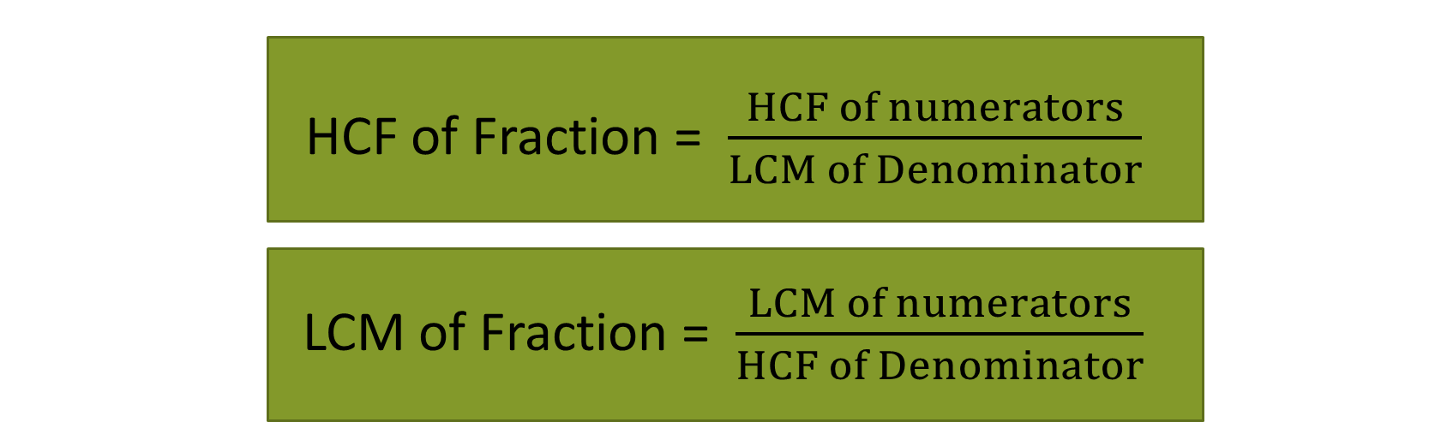
Important Formulae
Product of Two numbers = HCF × LCM

Slide 89
LCM Word Problems
Question | Answer
The Least number which is exactly divisible by x, y and z | LCM(x, y, z)
The least number which when divided by x, y, z leaves the same remainder R in each case | LCM (x, y, z) + R
The least Number which when divided by x, y and z, leaves remainder a, b and c respectively | LCM (x, y, z)-K Where K=(x-a)=(y-b)=(z-c)

Slide 90
HCF Word Problems
Question | Answer
The greatest number that will exactly divide x, y and z | HCF(x, y, z)
The greatest number that will divide x, y, z and leaves remainder R in each case | HCF(x-y, y-z, z-x) OR HCF(x-R, y-R, z-R)
The greatest Number that will divide x, y and z, leaving remainder a, b and c respectively | HCF(x-a, y-b, z-c)

Slide 91
Q) Find the lowest common multiple of 7, 8 and 4
[A] 56
[B] 240
[C] 360
[D] 480

Slide 92
The LCM of 5,8,12,20 will not be multiple of
[A] 16
[B] 120
[C] 40
[D] None

Slide 93
Q) The LCM of 1.05 and 2.1 is:
[A] 1.3
[B] 1.25
[C] 2.1
[D] None

Slide 94
Q)How many numbers between 200 and 600 are divisible by 4,5 and 6
[A] 5
[B] 6
[C] 7
[D] 8

Slide 95
Q) Three bells ring at an interval 9min, 12min, 15min respectively. If all the three bells ring at 8 am first, when will it ring again?

Slide 96
Q) Calculate the HCF of 2/3 ,16/81 and 8/9
[A] 2/9
[B] 8/3
[C] 2/81
[D] None

Slide 97
Q) The H.C.F of 5/7, 1/5, 2/3 ?
[A] 3/1400
[B] 5/1400
[C] 7/1400
[D] None

Slide 98
Q) Which of the following fraction is the largest? 1/8, 3/16, 29/40, 63/80
[A] 7/8
[B] 13/16
[C] 31/40
[D] 63/80

Slide 99
Two number are in the ratio of 15 : 11 and their H.C.F. is 13. Then find the numbers:
[A]230, 140
[B] 215,130
[C] 195,143
[D] 155,115

Slide 100
Q) The LCM of two numbers is 2310 and their H.C.F. is 30. If one of these number is 210 the second number is :
[A] 330
[B] 1470
[C] 2100
[D] 16170

Slide 101
The least perfect square number, which is divisible by 3,4,5,6, and 8 is
[A] 900
[B] 1200
[C] 2500
[D] 3600

Slide 102
Q) Find the HCF of 23,45,90,180,270
[A] 1
[B] 53
[C] 58
[D] None

Slide 103
The LCM of 5,8,12,20 will not be multiple of ?
[A] 3
[B] 9
[C] 5
[D] 8

Slide 104
Find HCF of 25,49,199,2999,3999
[A] 4
[B] 7
[C] 9
[D] 1

Slide 105
Find HCF of 2/3 , 4/5 , 6,7
[A] 2/105
[B] 1/7
[C] 1/11
[D] None

Slide 106
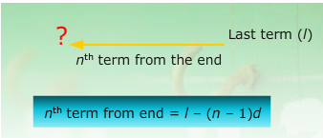
ARITHMETIC PROGRESSION
An Arithmetic Progression (A.P.) is a sequence in which the difference between any two consecutive terms is constant.
Let a = first term, d = common difference
Then nth term

Slide 107


Sum of an A.P

Slide 108
AM (Arithmetic mean)
If a, b, c are in AP then the arithmetic mean is given by
b = (a+c)/2

Slide 109
Inserting AM
To insert k means between a and b the formula for common difference is given by
d = (b-a) / (k+1)
For example: Insert 4 AM’s between 4 and 34
d= (34 - 4) / (4+1)
= 30/5
= 6
∴ The means are 4+6=10
10+6=16
16+6=22
22+6=28

Slide 110
Question: 3,8, 13, …….. Which term of this AP is 78?
[A] 25th
[B] 16th
[C] 17th
[D] 20th

Slide 111
Question: Find the 5th term of the series 5,15,45,……..
[A] 405
[B] 345
[C] 450
[D] 340

Slide 112
Question: How many terms are there in the GP 6, 12, 24, …….. 1536?
[A] 10
[B] 9
[C] 15
[D] 13

Slide 113
Question: Find the sum of the series 4,7,10,…….. Upto 20 terms
[A] 600
[B] 650
[C] 540
[D] 454

Slide 114
Sum of third and ninth term of an AP =8 find the sum of first eleven terms
[A] 44
[B] 22
[C] 19
[D] None

Slide 115
Question: Find the first term of an AP whose 8th and 12th terms are 19 and 27 respectively?
[A] 3
[B] 4
[C] 5
[D] 6

Slide 116
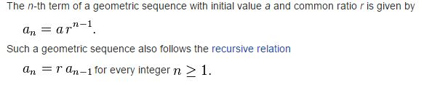
GEOMETRIC PROGRESSION
A geometric sequence are powers r^{k} of a fixed number r, such as 2^{k} and 3^{k}. The general form of a geometric sequence is

Slide 117
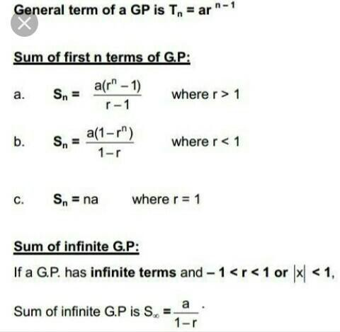

Slide 118
GM ( Geometric mean)
If a, b, c are in GP Then the GM is given by b = √ac

Slide 119
Inserting GM
To insert k means between a and b the formula for common ratio is given by
r = (b/a)^(1/(k+1))
For example: Insert 4 GM’s between 2 and 486
r = (486/2)^(1/(4+1)) = (243)^(1/5) = 3
∴ the means are 2x3 = 6
6x3 = 18
18x3 = 54
54x3 = 162

Slide 120
Question: How many terms are there in the sequence
7, 14, 28, 56, …….. 1792?
[A] 5
[B] 9
[C] 7
[D] None

Slide 121
Write 8th term in the series 1,3,9,…….
[A] 2187
[B] 2185
[C] 2287
[D] None

Slide 122
Question: Find the sum of the series 3, 5, 7, 9…. .31
[A] 255
[B] 1020
[C] 520
[D] None

